Slide 1
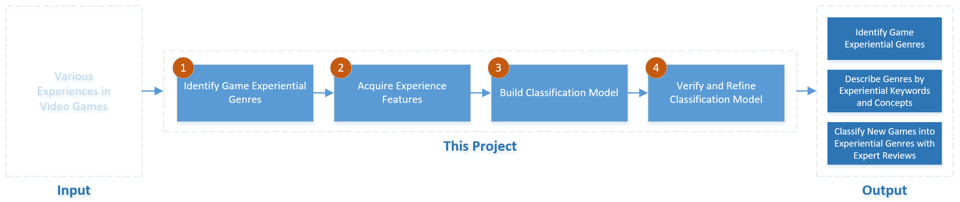
Project Overview
Notes:
Triplet survey + Content analysis for tagging -> model -> verify and refine model

Slide 2
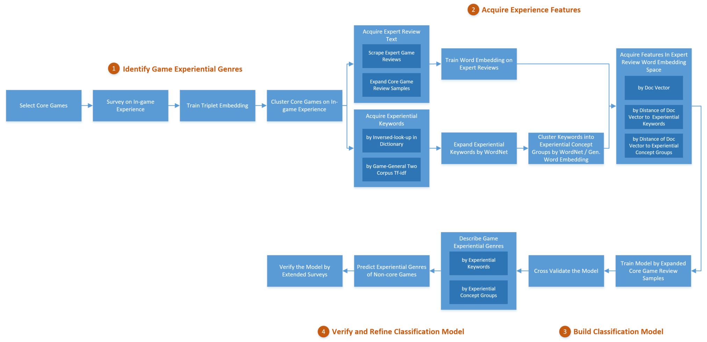
Technical Framework
Van Der Maaten, L., & Weinberger, K. (2012, September). Stochastic triplet embedding. In Machine Learning for Signal Processing (MLSP)
Bolukbasi, T., Chang, K. W., Zou, J. Y., Saligrama, V., & Kalai, A. T. (2016). Man is to computer programmer as woman is to homemaker? debiasing word embeddings. In Advances in Neural Information Processing Systems (pp. 4349-4357).
Notes:
To determine a good “similarity function” between objects – a kernel was built to help with clustering. To do this, surveys that employ t-Distributed Stochastic Triplet Embedding (t-STE) were used. The advantage of t-STE is that it reveals an underlying data structure by questioning annotators about the relative similarity of a to b & c. In a survey, participants select 5/25 games they know of and compare them with others for constructing the embedding. For e.g. “based on your in-game experiences, is Half-Life 2 more similar to RollerCoaster Tycoon or Metal Gear Solid?
K-means is then employed to produce recognizable clusters. We used the hand-picked core games to tag the clusters by in-game experience contained in their reviews.

